Slide 1
Multiple inheritance in c#

Slide 2
Multiple inheritance
Multiple inheritance is a feature in which a class can inherit characteristics and features from more than one parent class.

Slide 3
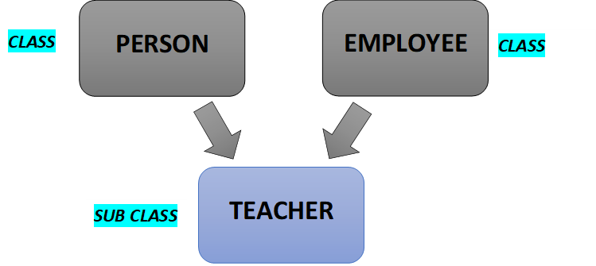
Multiple inheritance using classes

Slide 4
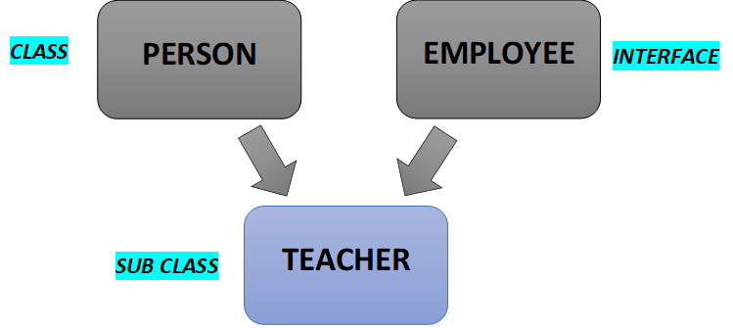

Multiple inheritance using interface

Slide 5
Multiple inheritance using interface
A class can extends or inherits only one class but a class can implements or inherits one or more than one interface.
In other words, a sub class can only have one parent class but a subclass can implements or inherits one or more than one interfaces.

